Slide 1
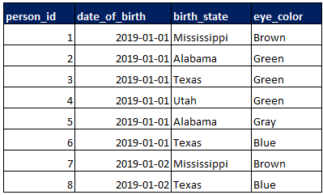
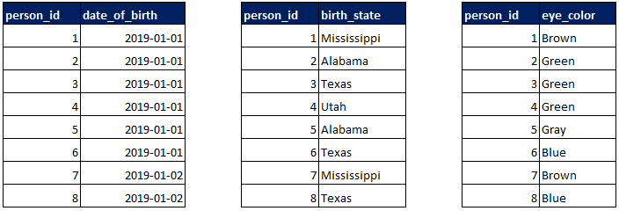
Row store vs column store
Row Store
Column Store
Notes:
“In a row-oriented indexed system, the primary key is the rowid that is mapped from indexed data. In the column-oriented system, the primary key is the data, which is mapped from rowids.”
“ That said, online transaction processing (OLTP)-focused RDBMS systems are more row-oriented, while online analytical processing (OLAP)-focused systems are a balance of row-oriented and column-oriented.”

Slide 2
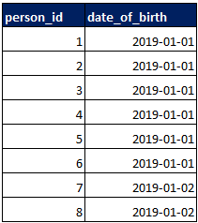

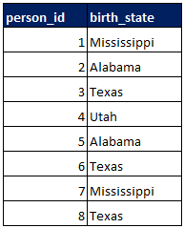
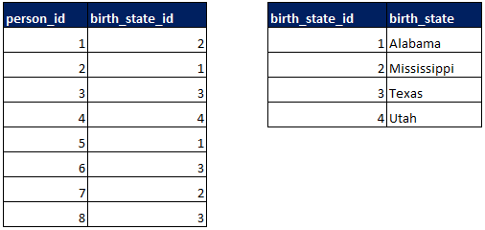
Column store compression
Run Length Compression
Dictionary Compression

Slide 3
More about data compression
Why dictionary compression works
SELECT DATALENGTH('Utah'); -- 4
SELECT DATALENGTH('Alabama'); -- 7
SELECT DATALENGTH(CAST('Alabama' AS NVARCHAR)); --14
SELECT DATALENGTH(CAST(1 AS TINYINT)); -- 1
SELECT DATALENGTH(CAST(255 AS TINYINT)); -- 1
Other compression types
Cluster Encoding, Sparse Encoding, Delta Encoding, Etc.
Cardinality and compression
High Cardinality = Most values in the column are unique.
Low Cardinality = The column contains a few distinct values.
In general, low cardinality columns will allow for a higher compression rate.
Column store + compression allows for in-memory and massively parallel processing

Slide 4
Where is column store used?
Relational Database Management Systems (RDBMS)
SQL Server Columnstore Indexes
SAP HANA
Enterprise Data Warehouse (EDW)
Amazon Redshift
Azure SQL Data Warehouse
Snowflake
Google BigQuery
Apache Hadoop
Parquet
ORC
Kudu
Online Analytical Processing (OLAP)
Analysis Services Tabular Models
Data Visualization Tools
Power BI Import (xVelocity in-memory analytics engine)
Tableau Data Extracts/Hyper

Slide 5
What is a snowflake “warehouse”?

Slide 6
Databases, roles, and users

Slide 7
LOADING DATA

Slide 8
CLONING

Slide 9
TIME TRAVEL

Slide 10
QUERYING SEMI-Structured data

Slide 11
EXTRACT, TRANSFORM, LOAD
Snowflake’s performance, ability to handle semi-structured types, and distinct storage and compute make it distinctly suitable for following an ELT pattern.
This means that virtually all of your data work can be handled on the database engine using SQL.
A wide range of data integration tools support Snowflake.
Any tool that supports connections via ODBC/JDBC can be used.

Slide 12
An example using dbt

Slide 13
Data visualization

Slide 14
From joint notes

Slide 15
DBA/Admin Stuff (10 min) - Hands-on (30 min)
Login and tab through the different interface elements
Create a Warehouse
Explain what a Warehouse is
It’s a bad name so bring clarity
Create a Database
Add a Role
Role-based authentication in Snowflake (Objects get assigned to roles, etc.)
Add a User/Users to that role
Grant Permissions to the Warehouse and Database to that created role

Slide 16
Loading Data (15 min) - Hands-On (30 min)
Loading Data (15 min) - Hands-On (30 min)
Introduce the Cassini Mission data set:
Cassini Mission and the data it gathered regarding Enceladus, Saturn's exciting, odd little moon.
Noticed some weird data and though the moon might be able to sustain lift so they did more passes around the moon. Detected an atmosphere.
Load from S3
Create a table within Snowflake
Use “Copy” command to import from S3
talk about the option to create a “Stage” within Snowflake
talk about the option to create or replace a “file format” within Snowflake
One from a delimited file format or JSON file format
Show off the Variant data type works - Load from a flat file, where one or more of the fields are JSON
Talk about the fact that Snowflake scales dynamically up and down (compute and storage are separate).
Don’t have to scale your compute just because you have to scale your storage

Slide 17
DBA/Admin Stuff (3 min) – Part II
Set limits on the Snowflake account (once it’s 50% allotment of account usage, etc.)
Here’s what your usage was to load the data, etc.

Slide 18
Run some example queries (5 min)
Run some example queries (5 min)
Filter to just fly by’s when they’re closest to the moon
Uses ANSI SQL - so anyone who writes SQL will write Snowflake

Slide 19
Transform Data (10 min)
Transform Data (10 min)
Use the transform example from the book
Talk about native integrations for ETL tools (show connecting to Matillion)
ODBC or JDBC drivers will also connect to Snowflake. Means in-theory you can still connect to other tools/workflows.

Slide 20
Model Data
Model data (10 min)
Use the modeling example from the book - update the Snowflake example
Talk about Eide Bailly and what we do (Data Modeling)

Slide 21
Transform Data (10 min)
Cloning (big deal for people working with Redshift)
click of the mouse (duplicate a table, schema, etc.)
doesn’t use any additional storage or compute
Time Travel (big deal for people working with Redshift)
Up to 90-days in the past
Can un-drop the table
Can query the data as of (certain date)
Show Data Sharing Feature
Show how sharing from one Snowflake account to another

Slide 22
Connect Viz Tool - Tableau (5-10 min)
Show how to connect to Tableau / Power BI show that it works. (5-10 min)
Build a report on the viz tool to show the fly by’s

